Slide 1
March 2020, Yukon College

Slide 2
Topics for today
About the Yukon Conservation Society
What is an abandoned mine?
What has to be done to abandoned mines?
Financial shenanigans
Government responsibilities
Financial security
Possible changes to the system

Slide 3
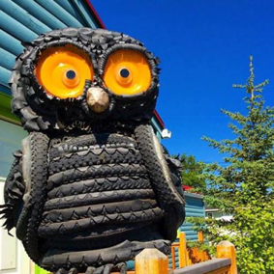
Yukon Conservation Society
The Yukon Conservation Society (YCS) is a grassroots environmental non-profit organization, established in 1968. We pursue ecosystem well-being throughout the Yukon and beyond, recognizing that human well-being is ultimately dependent upon fully functioning healthy ecosystems.
YCS is not against mining…we just want it done right and in appropriate areas
Learn more about us online:
www.yukonconservation.org
About the Yukon Conservation Society

Slide 4
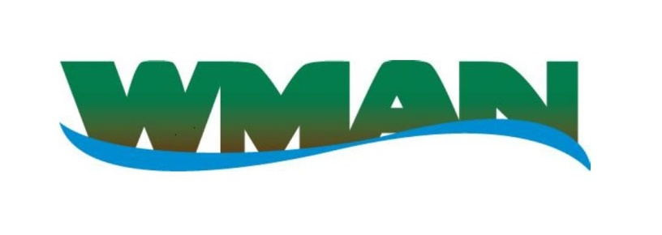
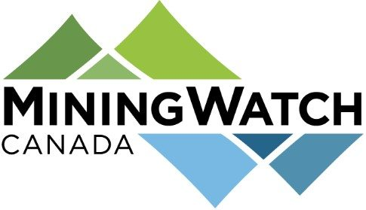
Thank you sponsors!
And these groups who enable us to be a ‘watchdog’ for mining in the Yukon:

Slide 5
Topics for tonight
About the Yukon Conservation Society
What is an abandoned mine?
What has to be done to abandoned mines?
Financial shenanigans – sending in the accountants
Government steps up to shoulder the burden
Financial security
What is to be done

Slide 6
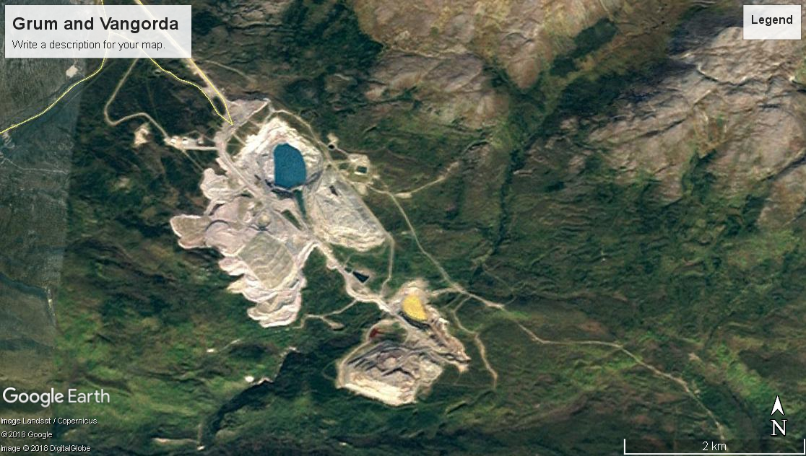
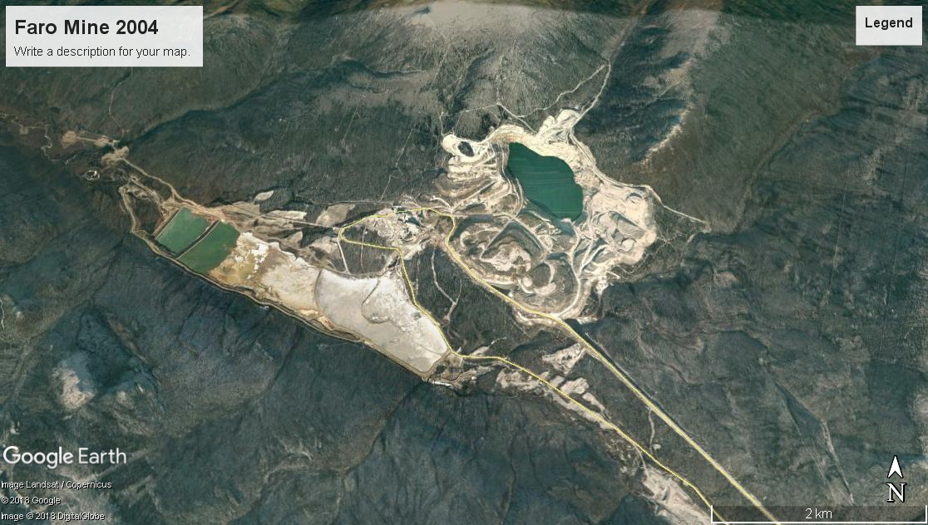
What is an abandoned mine?
Orphaned or abandoned mines are those mines for which the owner cannot be found or for which the owner is financially unable or unwilling to carry out clean-up.
National Abandoned/Orphaned Mine Initiative (NAOMI) http://www.abandoned-mines.org/en/
What is an abandoned mine?

Slide 7
Abandoned Mines = Quartz Mines
Quartz mining (hard rock mining): the mining of gold on veins or ore bodies in place, as distinguished from placer mining (surface digging or washing)
Abandoned Mines tend to always be Quartz Mines
Partly due to size
Partly due to complex chemistry
Partly due to length of environmental contamination
What is an abandoned mine?

Slide 8
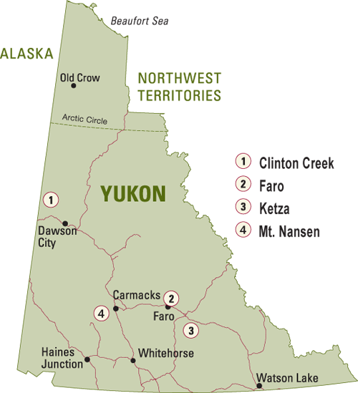
Abandoned mines in the Yukon
Clinton Creek
Faro Mine
Ketza River
Mt Nansen
Keno Complex
Wolverine Mine
5
5
Keno
http://www.emr.gov.yk.ca/aam/location_type_two_mines.html
Modified by YCS
What is an abandoned mine?

Slide 9
Keno – example of the future?
Elsa Reclamation and Development Company Ltd., a unit of Alexco Resource Corp., owns the former assets of United Keno Hill Mines (UKHM) and is responsible for the care and maintenance of the properties and the eventual reclamation and closure of the overall UKHM sites through a funding agreement with Yukon and Canada.
Alexco Keno Hill Mining Corp., a separate subsidiary of Alexco Resource Corp., has been incorporated for the purpose of mineral extraction.
Faro and Mt. Nansen are taking a similar route.
http://www.emr.gov.yk.ca/mining/bellekeno.html
What is an abandoned mine?

Slide 10
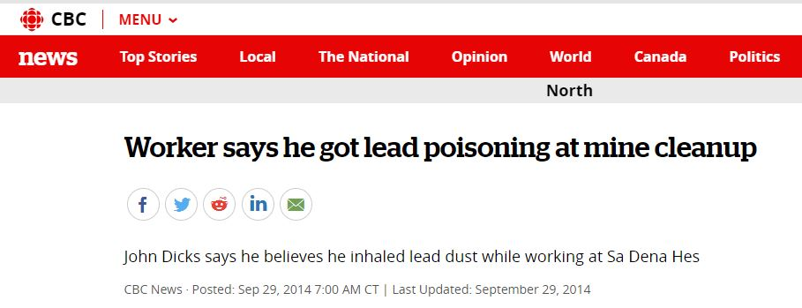
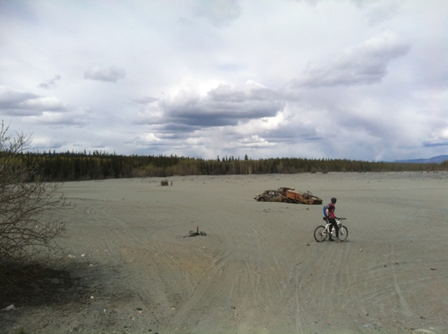
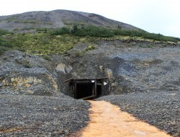
Mine sites of note (but not abandoned)
Whitehorse Copper
Brewery Creek
Sa Dena Hes
Tom Adit
What is an abandoned mine?

Slide 11
Topics for tonight
About the Yukon Conservation Society
What is an abandoned mine?
What has to be done to abandoned mines?
Financial shenanigans – sending in the accountants
Government steps up to shoulder the burden
Financial security
What is to be done

Slide 12
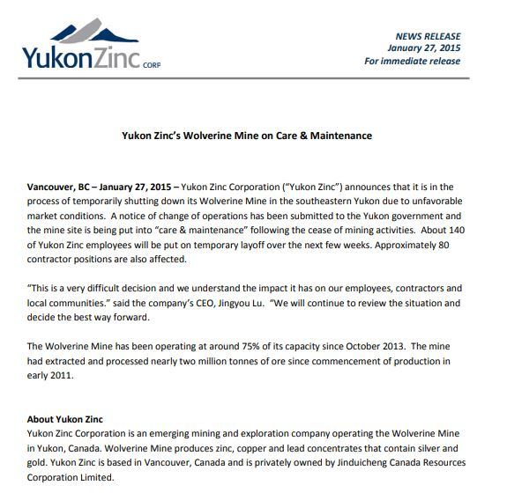
Abandoned mines need…
Care and Maintenance: Ongoing activities such as site inspections, water monitoring and treatment, site safety and security to protect human health, safety and the environment.
Remediation: Treating or removing contaminants from a site for the protection of human health and the environment.
http://www.emr.gov.yk.ca/aam/pdf/201311_factsheet_aam_remediationprocess.pdf
What has to be done to abandoned mines?

Slide 13
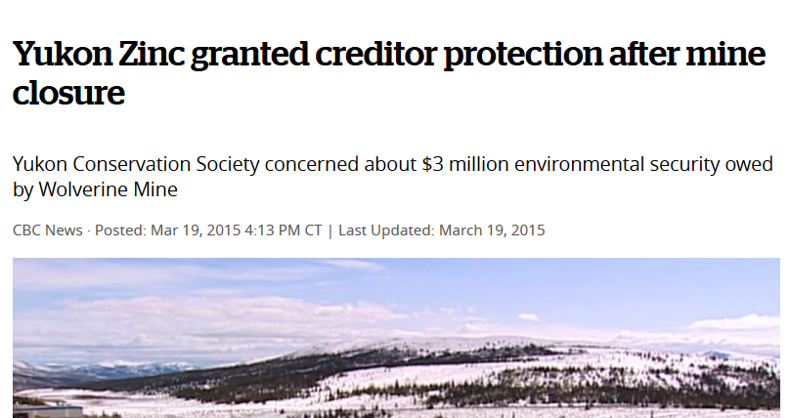
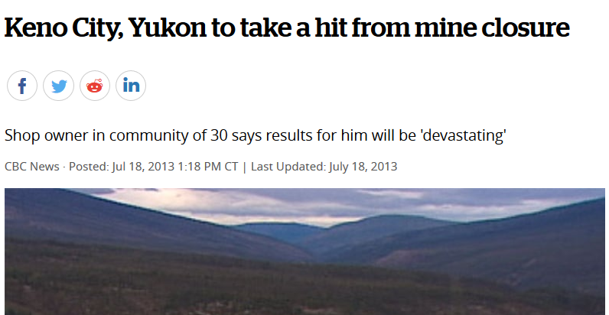
Mine closure isn’t necessarily abandonment
Mine closure is a term used by the mining industry to describe a period of time when the extracting activities at a mine site have ceased but the final decommissioning of site infrastructure and reclamation of disturbed areas has not been completed. http://www.emr.gov.yk.ca/aam/remediation_planning.html
What has to be done to abandoned mines?

Slide 14
Temporary closure
Closure in which mining-related activities cease with the intent of resuming activities in the near future.
May be planned or unplanned and could arise from a variety of circumstances including financial challenges, design failures, extreme climatic conditions, etc.
Temporary closures may last for weeks, or could extend for years. Maximum durations of temporary closure periods are frequently defined in QMLs and WLs.
Permanent closure is a closure in which there is no intent to resume mining activities at the site and the mine project proceeds to remediation – ideally.
http://www.emr.gov.yk.ca/mining/pdf/mml_reclamation_closure_planning_quartz_mining_projects_aug2013.pdf
What has to be done to abandoned mines?

Slide 15
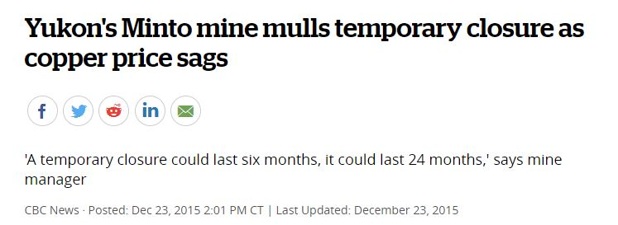
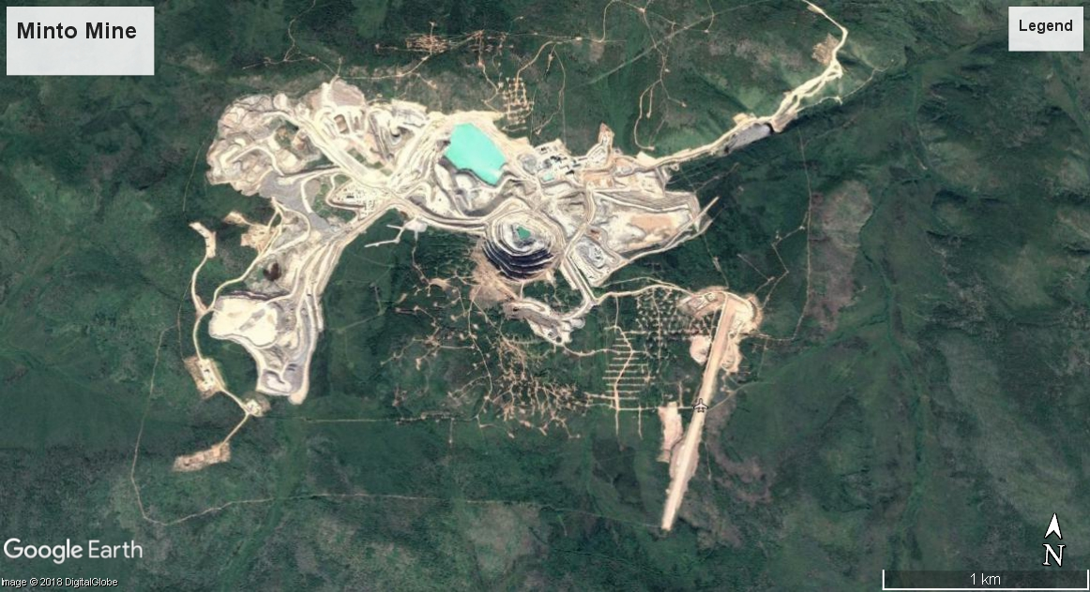
Temporary closures in the Yukon
Wolverine Mine
Minto Mine
What has to be done to abandoned mines?

Slide 16
Remediation vs. reclamation
Remediation: Treating or removing contaminants from a site for the protection of human health and the environment.
http://www.emr.gov.yk.ca/aam/pdf/201311_factsheet_aam_remediationprocess.pdf
Reclamation: A term used by the mining industry to describe the process of restoring land that has been mined to a natural or economically usable purpose once mining activities have ceased on the site.
http://www.emr.gov.yk.ca/aam/remediation_planning.html
What has to be done to abandoned mines?

Slide 17
Topics for tonight
About the Yukon Conservation Society
What is an abandoned mine?
What has to be done to abandoned mines?
Financial shenanigans – sending in the accountants
Government steps up to shoulder the burden
Financial security
What is to be done

Slide 18
Mining companies: Privatizing profits, socializing risks
A company is a legal entity which permits a group of people (shareholders) to apply to the government for an independent organization to be created, which can pursue set objectives and is empowered with legal rights usually reserved for individuals, such as to sue and be sued, own property, hire employees or loan and borrow money.
The primary advantage is that it provides the shareholders with a right to participate in the profits without any personal liability.
Financial shenanigans

Slide 19
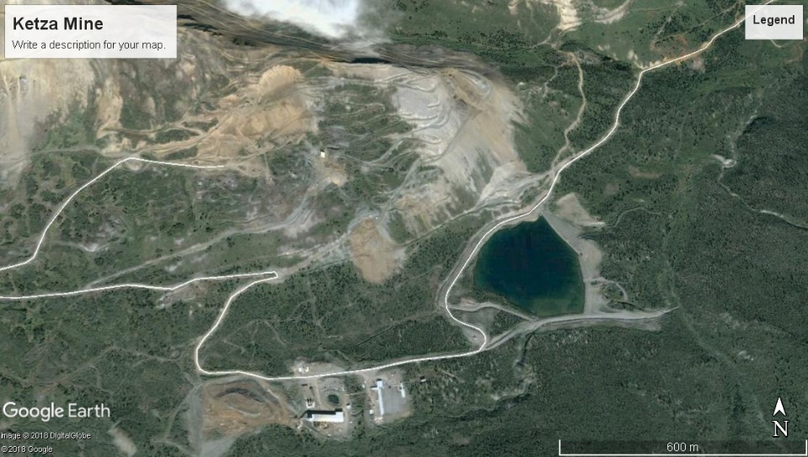
When mining companies can’t pay the bills
When companies get into serious financial trouble and cannot pay their debts, they have three possible remedies:
Selling the company to another company;
Seeking to “restructure” under the Companies’ Creditors Arrangement Act;
Going bankrupt under the Bankruptcy and Insolvency Act.
Understanding mining company bankruptcy and restructuring in Canada, Joan Kuyek DSW
Financial shenanigans

Slide 20
Federal legislation to the rescue (for the miners)
The Companies’ Creditors Arrangement Act (CCAA) is “to facilitate compromises and arrangements between companies and their creditors”. The Act provides a method by which the company is “restructured” by way of a court-appointed “monitor” or trustee to satisfy at least 2/3 of those to whom the company owes money. Generally all creditors receive a portion of what they are owed, so that the company can continue to operate.
The Bankruptcy and Insolvency Act can be used at the same time as the CCAA but is usually involved after the CCAA process has failed. The debtor company’s assets are placed in the hands of a trustee appointed by the court. The assets and/or the company itself are sold (usually for very little) and the receipts distributed to those to whom the company owed money. This is called liquidation. This process can take a very long time to be resolved.
Understanding mining company bankruptcy and restructuring in Canada, Joan Kuyek DSW
Financial shenanigans

Slide 21
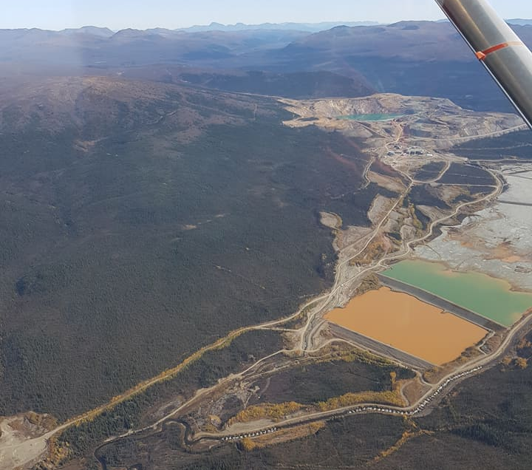
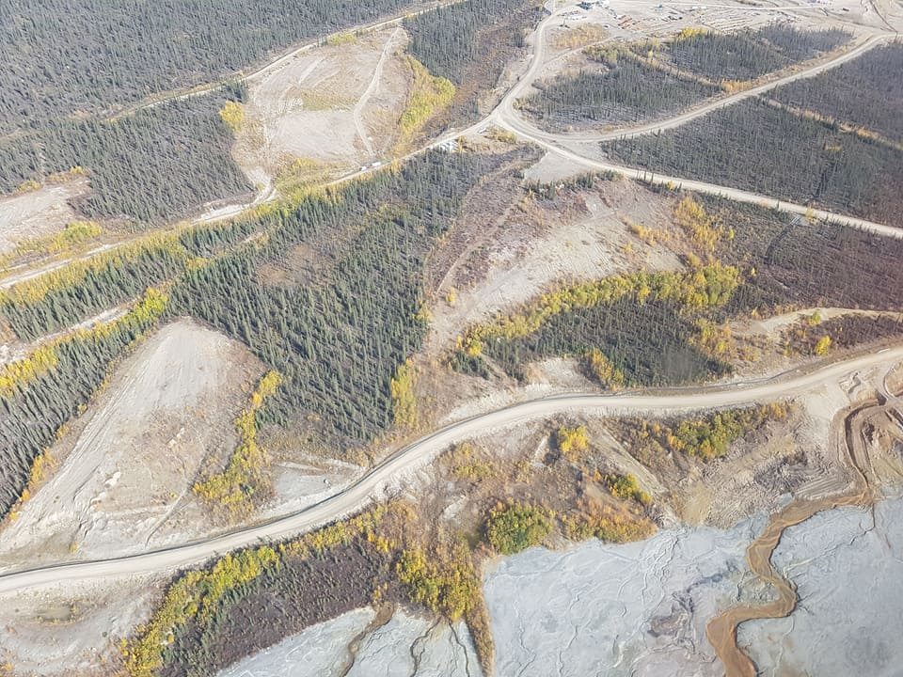
Who’s in charge?
Receivership: A situation where a company, the receiver, is placed in a custodial position to manage the assets, property, rights and affairs of another organization.
http://www.emr.gov.yk.ca/aam/resources.html
Often, the company that takes over has no mining expertise.
Faro Mine
Financial shenanigans

Slide 22
Who gets paid?
During either process, money is distributed to these groups in the following order of priority:
The administrative costs of the bankruptcy or monitor
Workers and employees and employee pension plans
Government obligations (taxes, health tax, unremitted worker deductions, EI, etc.)
Secured creditors
Equity interest (shares, interest, etc.)
Unsecured creditors (many small businesses)
E.g. Wolverine restructuring: creditors owed more than $5,000 got up to 11.5 cents on the dollar; those owed less than $5,000 paid in full. 273 creditors, representing $20,659,309 in claims.
https://www.cbc.ca/news/canada/north/yukon-zinc-creditors-vote-yes-to-restructuring-plan-1.3213210
Not on the list: care/maintenance and remediation (separate bond)
Understanding mining company bankruptcy and restructuring in Canada, Joan Kuyek DSW
Financial shenanigans

Slide 23
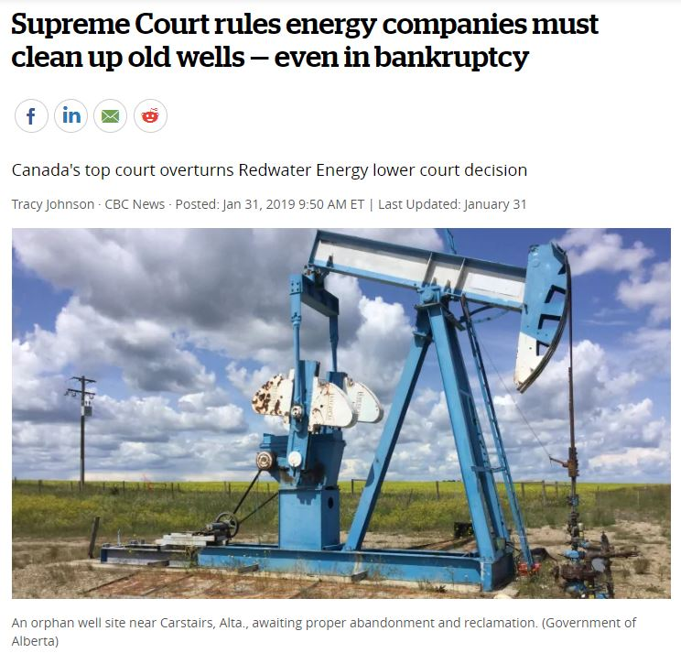
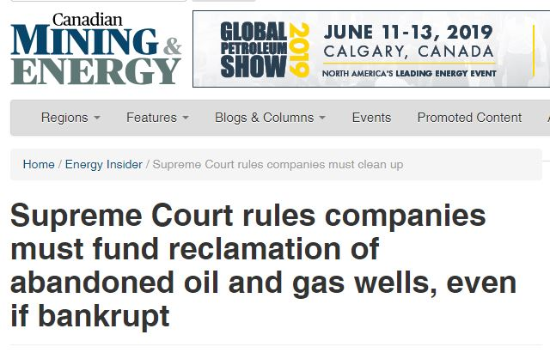
Supreme Court of Canada and Redwater
Financial shenanigans

Slide 24
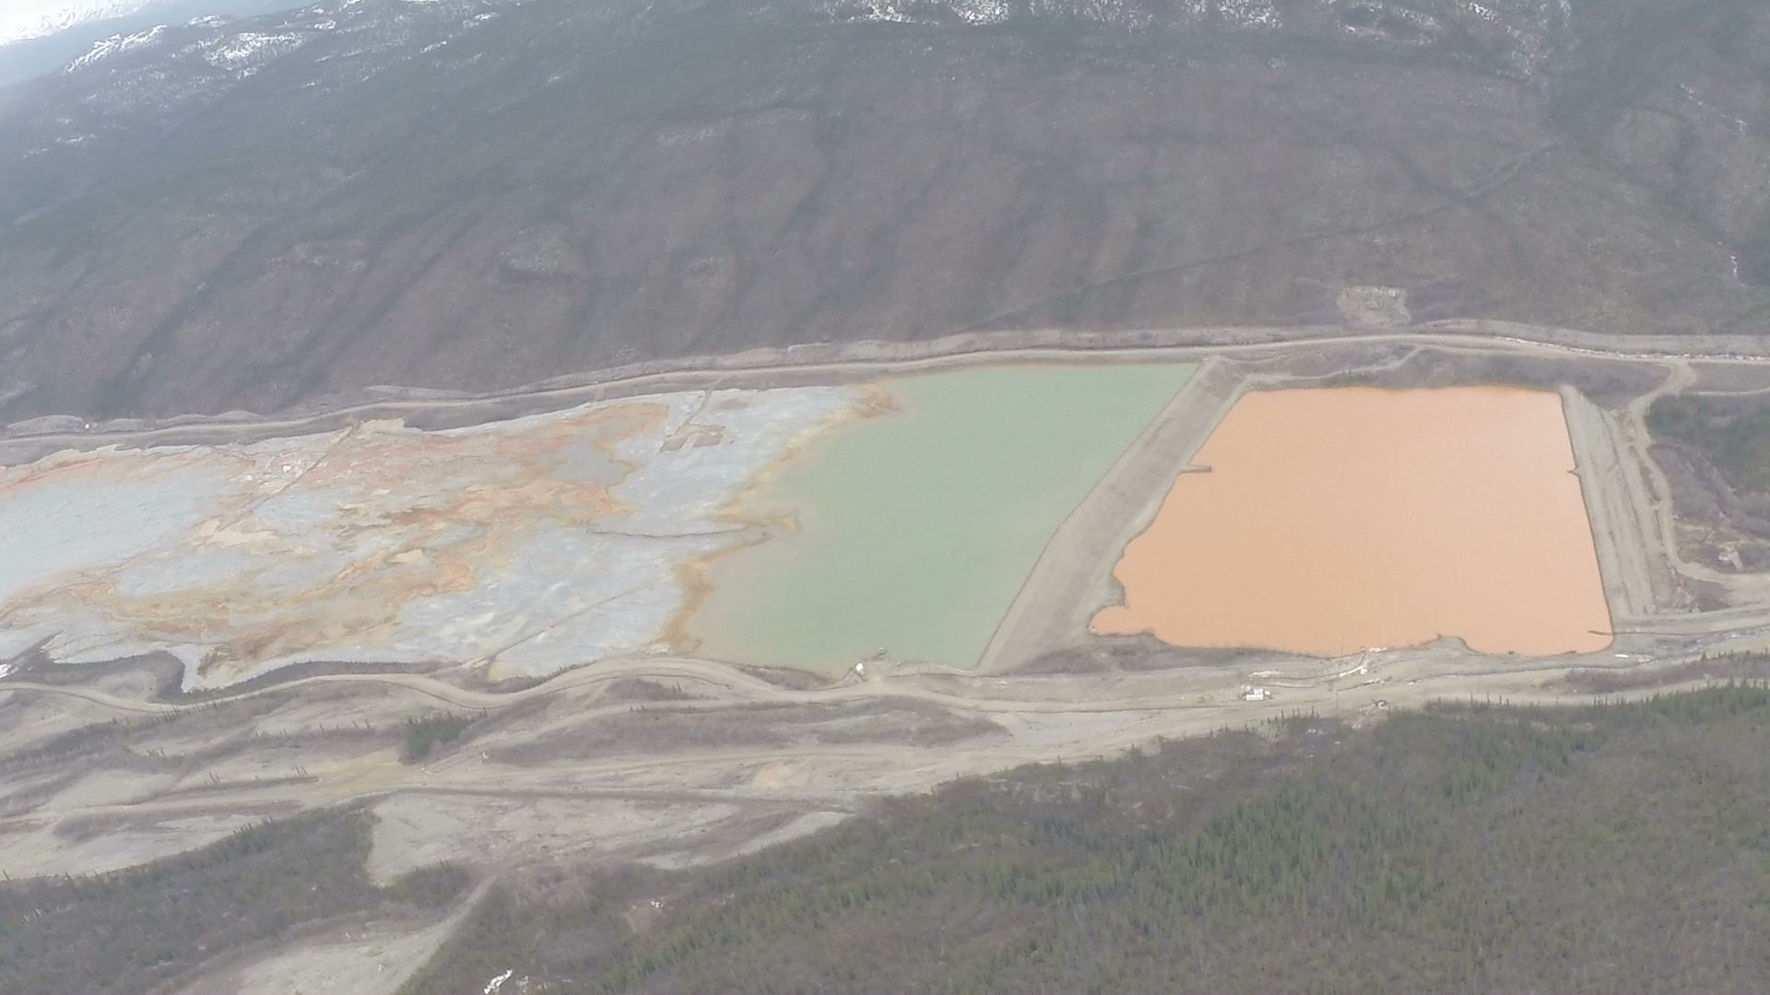
Are company directors liable?
Directors have personal liability only for unpaid wages, accrued vacation pay and termination and severance pay.
Taxpayers (not company directors) paying for care/maintenance and remediation of the Faro Mine tailings and related ponds
- pic Yukon Conservation Society
Financial shenanigans

Slide 25
Topics for tonight
About the Yukon Conservation Society
What is an abandoned mine?
What has to be done to abandoned mines?
Financial shenanigans – sending in the accountants
Government steps up to shoulder the burden
Financial security
What is to be done

Slide 26
Is the federal government responsible?
Yes, but only for mines approved prior to April 1, 2003.
Yukon Government (Assessment and Abandoned Mines branch) is responsible for administrative care and control of abandoned sites: ongoing care and maintenance operations and the development and implementation of a remediation plan.
Financial responsibility for abandoned Type II sites resides with the federal government. It provides 100% of the funding for site care and maintenance operations as well as for the development of long-term remediation plans. This funding is provided through the Federal Contaminated Sites Action Plan . The federal responsibility is managed through the Department of Indigenous and Northern Affairs Canada (INAC).
http://www.emr.gov.yk.ca/aam/about_abandoned_mines.html
Government steps up

Slide 27
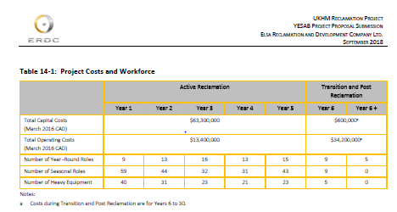
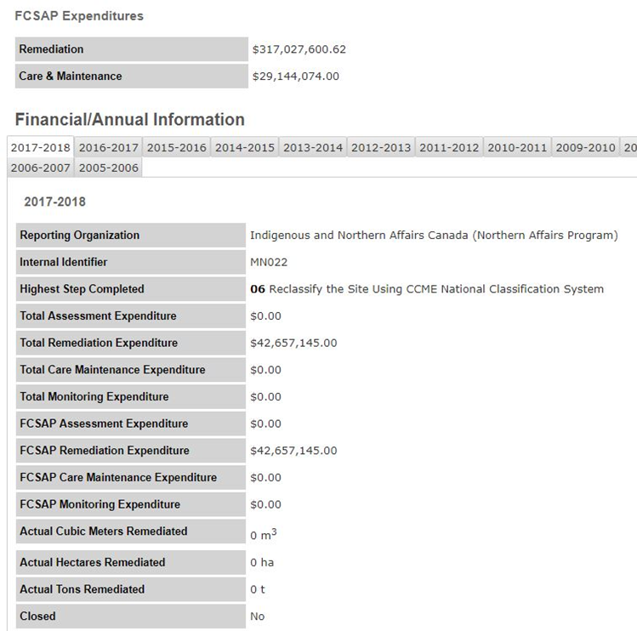
Federal costs
Keno
$111.5 million
https://yesabregistry.ca/wfm/Project/nulljr9rut0p660
Clinton Creek
About $3 million spent to date, anywhere from $20-$80 million to remediate (YCS guesstimate)
Mt Nansen
Ottawa has spent about $20 to $25 million to monitor and control the site since 2004 https://www.cbc.ca/news/canada/north/mount-nansen-mine-remediation-byg-yukon-judge-1.3940051
Will probably take $70-$90 million to clean up
Faro Mine
Cleanup estimated to cost more than $500 million (and have spent $350 million so far)
https://www.cbc.ca/news/canada/north/faro-mine-remediation-1.4179016
Ketza River Mine
Have spent $3.1 million (as of 2015)
https://www.cbc.ca/news/canada/north/yukon-s-ketza-mine-abandoned-by-veris-gold-1.3041984
Government steps up

Slide 28
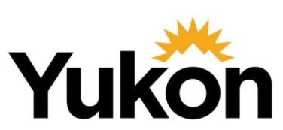
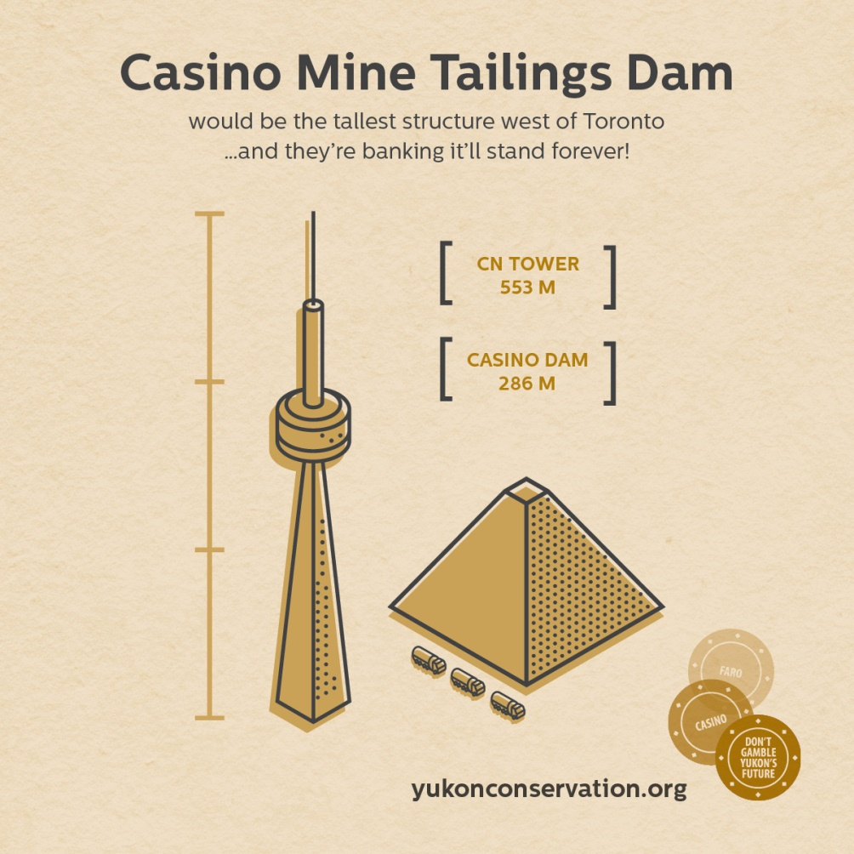
Is Yukon Government responsible?
Yes, but only after April 1, 2003. Yukon took over land and resource management responsibilities from the Government of Canada in devolution.
This means Yukon could be responsible for…
Wolverine
Victoria Gold
Coffee
Casino
http://www.emr.gov.yk.ca/aam/about_abandoned_mines.html
Government steps up

Slide 29
Topics for tonight
About the Yukon Conservation Society
What is an abandoned mine?
What has to be done to abandoned mines?
Financial shenanigans – sending in the accountants
Government steps up to shoulder the burden
Financial security
What is to be done

Slide 30
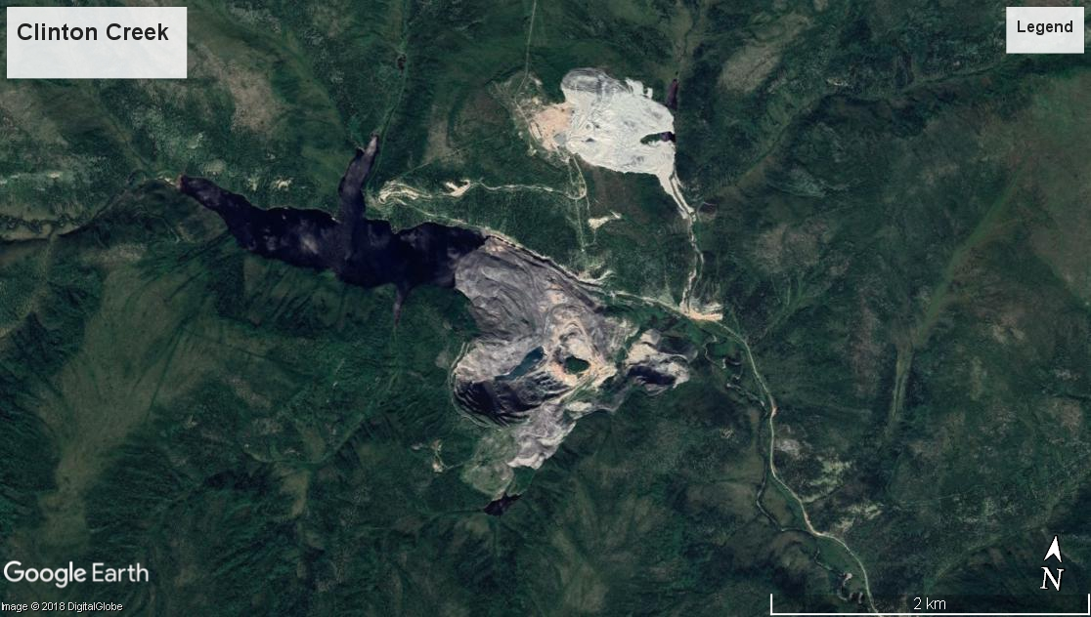
What is security?
“Where there is risk of significant adverse environmental effect…”
Yukon Quartz Mining Act
Financial security

Slide 31
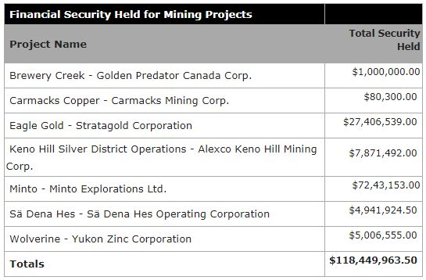
Yukon financial security
Financial security for mining and exploration projects in Yukon is held under a quartz mining licence, a mining land use approval or a Type A/B water licence.
The amount and form of security is determined pursuant to the Quartz Mining Act and the Waters Act.
http://www.emr.gov.yk.ca/mining/security_held_mining_projects.html
Financial security

Slide 32
How is security determined?
Company puts forwards a figure
Yukon Environmental and Socio-economic Assessment Board (YESAB) looks at it but can only make a recommendation regarding it
Yukon Government looks at it (forms part of the mining license) and determines an amount (there’s discussion with the company)
Yukon Water Board (YWB) looks at it and can also determine an additional amount
Financial security

Slide 33
Wolverine Mine – we’ve learnt nothing
http://www.emr.gov.yk.ca/mining/pdf/mml-wolverine-emr-security-letter-20180503.pdf
Financial security

Slide 34
The YCS guesstimate of taxpayer liability
Federal:
Faro $500 million
Keno Complex $111 million
Mt Nansen $70-90 million
Clinton Creek $20-80 million
Ketza River $25 million
Montana Mtn Sites $10 million
For comparison….
Yukon Arts Fund $500,000 annually
Conrad campground $576,000 from YG
Centre of Hope $14 million total
New Francophone school $29 million total (est.)
FH Collins rebuild $51 million total
https://yukon.ca/en/arts-and-events/apply-arts-fund
https://www.yukon-news.com/life/new-government-campground-boasts-historic-past/
https://www.yukon-news.com/news/yukon-government-to-take-over-centre-of-hope-building-from-salvation-army/
https://www.whitehorsestar.com/News/contract-for-29m-awarded-for-francophone-high-school
https://www.yukon-news.com/news/demolition-costs-for-old-f-h-collins-building-higher-than-expected/
Yukon:
Wolverine $25 million
Financial security

Slide 35
Topics for tonight
About the Yukon Conservation Society
What is an abandoned mine?
What has to be done to abandoned mines?
Financial shenanigans – sending in the accountants
Government steps up to shoulder the burden
Financial security
What is to be done

Slide 36
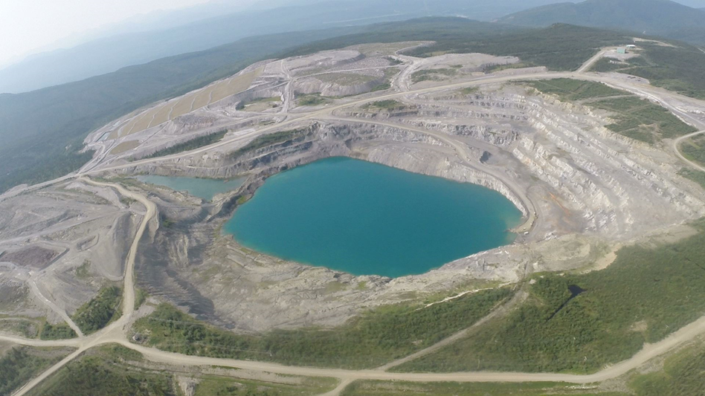
How the public can ask for adequate security
During the YESAB public comment process
During the YWB public comment process
...or we can change the system
Faro mine
What is to be done

Slide 37
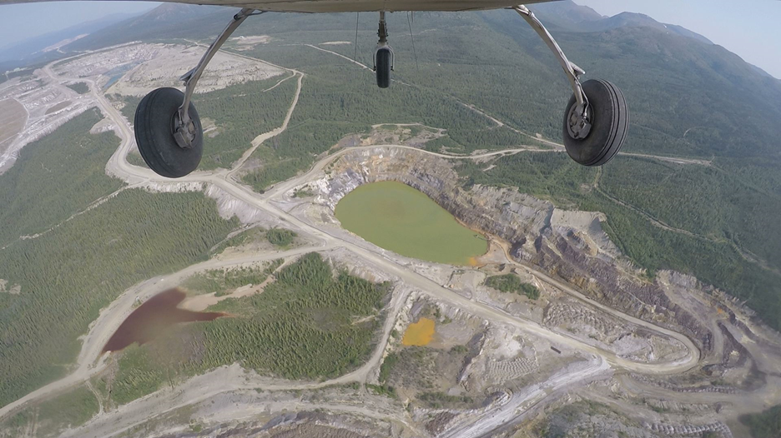
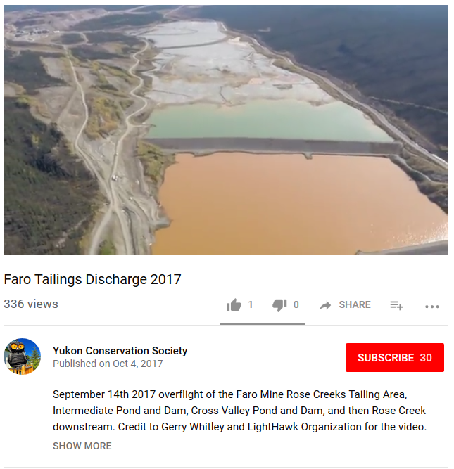
What YCS is doing
Submitting environmental comments during YESAB and Water Board processes
Raising public awareness with presentations, campaigns, interviews with media
Advocating for changes in policy and legislation
Keeping an eye on mines (thanks LightHawk!)
What is to be done

Slide 38
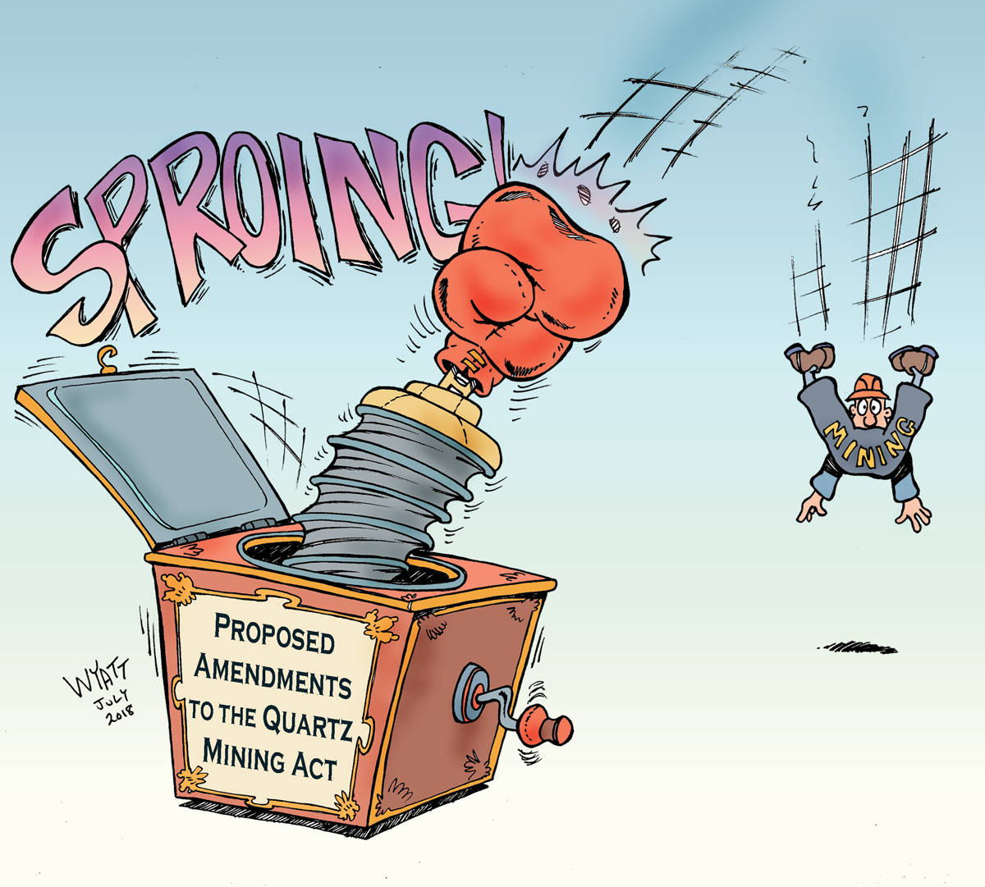
What more could be done?
Change the bankruptcy laws regarding mining (should Directors be liable?)
Increase the financial security mining companies must pay (better to have too much than too little?)
Approve mines with acceptable and realistic closure plans and appropriate funding
Establish an Abandoned Mine fund
These can be part of the cost of doing business in a stable, politically supportive environment
What is to be done

Slide 39
Conclusions
Mining in the Yukon is sometimes about
privatizing profit and socializing risk,
which means taxpayers pay for cleanup.
Getting sufficient financial security before things go bad is important – but hard.

Slide 40
Thank You
Thank you to our sponsors, members, and volunteers,
especially our mining committee.
Become a YCS member to support more work like this!

Slide 41
Questions?
Lewis Rifkind, Mining Analyst
Yukon Conservation Society
867-668-5678
mining@yukonconservation.org
www.yukonconservation.org

