Slide 1
The Yukon and the Arctic
Plan of the presentation
- Geographical overview
- The inuvialuit settlement region
-Maritime boundaries
- Beaufort Sea Meltdown
- Wildlife and Fisheries
- Oil and gas in the beaufort sea

Slide 2
The Yukon and the Arctic
Geographical overview

Slide 3
The Arctic Region
https://www.cia.gov/library/publications/the-world-factbook/docs/refmaps.html

Slide 4
The Beaufort Sea
http://www.worldatlas.com/aatlas/infopage/beaufortsea.htm

Slide 5
The Mackenzie River
http://gordonfoundation.ca/sites/default/files/images/2014-03-07%20-%20ScreeningGuide_FINAL.pdf

Slide 6
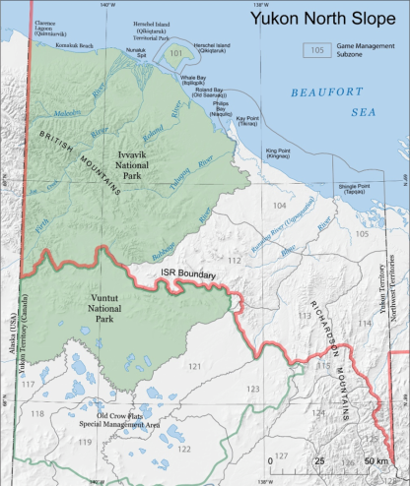
The Yukon North Slope
http://www.wmacns.ca/pdfs/198_YNSandGameManagementSubzones.pdf

Slide 7
The Yukon and the Arctic
The inuvialuit settlement region

Slide 8
The Inuvialuit Settlement Region Relative to Canada
The ISR covers 906 430 km²
In 2006, there were 5 756 inhabitants in the ISR; 3 115 were Inuvialuit
https://www.neb-one.gc.ca/glbl/nwt-nnvt-mp-eng.html

Slide 9
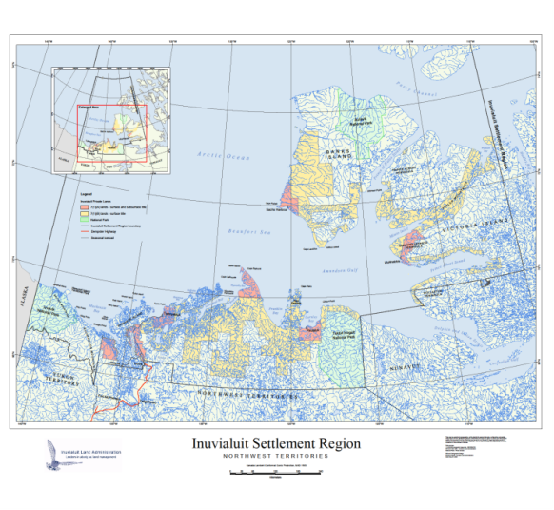
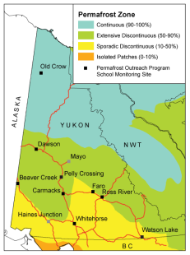
Private Lands (Class A and B lands) in the ISR
*Class A Land is in pink (total of about 13 000 km²) , and Class B Land in yellow (total of about 77 700 km² )
The Inuvialuit Settlement Region is determined by the Inuvialuit Final Agreement and the Western Arctic Claims Settlement Act, signed in 1984.
http://www.inuvialuitland.com/resources/Inuvialuit_Settlement_Region_Map.pdf

Slide 10
Private Lands Separated in Communities
http://eirb.ca/wp-content/uploads/2015/12/EIRB_Annual-Report-2014-2015.pdf

Slide 11
Diagram of the Co-management System
http://eirb.ca/wp-content/uploads/2015/01/pano_co-mgmt-tree_dl_1_edited-1_alt_colors.pdf

Slide 12
Inuvialuit Corporations
Inuvialuit Regional Corporation
Inuvialuit Investment Corporation
Inuvialuit Development Corporation
Inuvialuit Petroleum Corporation
Inuvialuit Land Corporation

Slide 13
The Yukon and the Arctic
Maritime boundaries

Slide 14
Maritime Boundaries in the Arctic Ocean
*Plain green = Canada Territorial Sea and Exclusive Economic Zone Dashed green = Potential Canada extended continental shelf
The United Nations Convention on the Law of the Sea (UNCLOS) determines Sea Regulations in the Arctic
https://www.dur.ac.uk/resources/ibru/resources/Arcticmap04-08-15.pdf

Slide 15
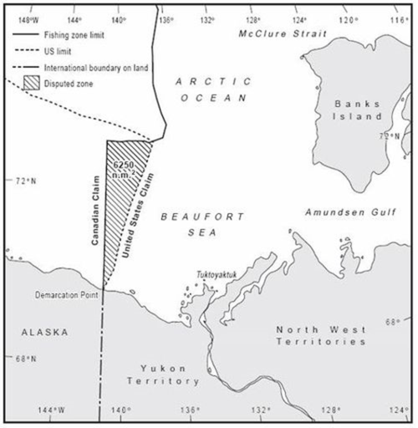
Disputed Area in Beaufort Sea
The disputed area covers about 21 000 km²
According to Canada’s National Energy Board, the disputed area contains a potential 1.7bn cubic metres of gas and over 1bn cubic metres of oil.
http://benmuse.typepad.com/arctic_economics/2009/08/us_canada_beaufort_sea_boundary.html

Slide 16
The Yukon and the Arctic
The arctic meltdown

Slide 17
Band of different ice types in Beaufort Sea in 2014
*White = Multi year ice
Purple = First year ice
Green = Fast, coastal ice
http://www.ec.gc.ca/glaces-ice/default.asp?lang=En&n=6A569020-1

Slide 18
The feedback effect
Longer melt down period
More thin, first year ice and less thick, multi year ice
Thin ice cracks more easily
Large areas of open water are created in the Arctic Ocean
Global warming
Seawater absorbs the heat from the sun instead of reflecting it

Slide 19
Some consequences of the meltdown
Disrupting the Inuvialuit way of life
Disrupting the wildlife
Creating erosion on coastlines
Altering the northern hemisphere meteorology
Raising of the global sea level
Increasing commercial interests in the Arctic

Slide 20
The Northwest Passage
http://www.theglobeandmail.com/news/world/china-reveals-plans-to-ship-cargo-across-canadas-northwest-passage/article29691054/

Slide 21
The Yukon and the Arctic
Wildlife and fisheries

Slide 22
Wildlife in the Yukon North Slope and Beaufort Sea
Animals only or mostly present in the Yukon North Slope and/or the Beaufort Sea | Yukon Conservation status | Global Conservation Status
Polar Bear | S1 (Critically Imperilled) | G3 (Vulnerable)
Barren Ground Caribou (includes the Porcupine Caribou Herd) | Not yet assessed | Not yet assessed
Bowhead Whale | S3 (Vulnerable) | G3 (Vulnerable)
Arctic Fox | S2 (Imperilled) | G5 (Secure)
Beluga | S4 (Apparently Secure) | G4 (Apparently Secure)
Muskox | S1 (Critically Imperilled) / S2 (Imperilled) | G5 (Secure)
Wolverine | S3 (Vulnerable) | G4 (Apparently Secure)
Seal (Hooded, Bearded, Spotted and Ringed) | SNA, S4, SU and S3 | G4G5, G4G5, G4G5, G5
Animals present in all or the majority of the Yukon, including the North Slope (all S4 or S5 and G5)
Moose
Canada Lynx
Red Fox
Grey Wolf
Ermine
Arctic Ground Squirrel
Shrew
Vole
Least Weasel

Slide 23
Trends in Polar Bear Subpopulations in June 2015
http://awsassets.wwf.ca/downloads/polar_bear_subpopulations_size_trend_2015_landscape_june_2015.pdf

Slide 24
Preferential rights for the Inuvialuit in harvesting
Under the Inuvialuit Final Agreement, Inuvialuit have
The preferential right to harvest all species of wildlife, except some birds throughout the Yukon North Slope (IFA, 12 (24) (a))
The exclusive right to harvest [muskox (IFA, 14(6)(c))] furbearers and polar bears throughout the Yukon North Slope (IFA, 12 (24) (a))
The exclusive right to harvest game within Ivvavik National Park and Herschel Island Territorial Park (IFA, 12 (24) (a))
The exclusive right to harvest on Private Inuvialuit lands (IFA, 14(6)(d)).
The first priority to harvest marine mammals (IFA, 14(29)), and preferential right to harvest fish (IFA, 14(31)).
The right to receive financial compensation for wildlife damages (IFA, 13(1))

Slide 25
Diagram of the Co-management System
http://eirb.ca/wp-content/uploads/2015/01/pano_co-mgmt-tree_dl_1_edited-1_alt_colors.pdf

Slide 26
Maritime Boundaries in the Arctic Ocean
*Dashed zone and lighter colored zones = potentially claimed and claimed continental shelves
https://www.dur.ac.uk/resources/ibru/resources/Arcticmap04-08-15.pdf

Slide 27
Trudeau’s and Obama’s promises
March 2016: Trudeau and Obama « call for a binding international agreement to prevent the opening of unregulated fisheries in the central Arctic Ocean to preserve living marine resources and promote scientific research in the region. [They also] pledged to create a pan-Arctic marine protection area network, including at least 10 per cent of their Arctic waters and 17 per cent of their Arctic land mass, committing to substantially surpass these national goals in the coming years.»
http://www.cbc.ca/news/politics/us-canada-arctic-protection-1.3486062

Slide 28
The Yukon and the Arctic
Oil and gas offshore

Slide 29
Oil and gas potential in the Beaufort Sea
“Recent studies have suggested that the Arctic contains over a quarter of the world’s untapped natural gas reserves, and about 13 percent of its undiscovered oil reserves.” http://www.conocophillips.ca/our-operations/canadian-arctic/Pages/default.aspx
“The Beaufort Sea […] is estimated to contain 40 trillion cubic feet of natural gas and 4,500 million barrels of oil.” http://www.emr.gov.yk.ca/oilandgas/pdf/yukon-oil-and-gas-annual-report-2015.pdf
1950: First hydrocarbon exploration in the Beaufort Sea
1972 to 1992: 92 wells drilled
1992 to 2016: 1 well drilled

Slide 30
Licences in the Beaufort Sea in 2012
“There [were] 16 Exploration Licences, 48 Significant Discovery Licences and no Production Licences in the Beaufort Sea [in 2015].” http://www.emr.gov.yk.ca/oilandgas/pdf/yukon-oil-and-gas-annual-report-2015.pdf
https://www.aadnc-aandc.gc.ca/eng/1335971994893/1335972853094

Slide 31
Trudeau’s and Obama’s promises
March 2016: [Trudeau and Obama] promised to be strict about licensing any kind of Arctic development, and to "set a world-class standard by basing development decisions and operations on scientific evidence." ” http://www.cbc.ca/news/politics/us-canada-arctic-protection-1.3486062

Slide 32
Who owns the Beaufort Sea?
The Canada Yukon Oil and Gas Accord signed in 1993 had the purpose to introduce a shared management and revenue system for the offshore Yukon’s waters between Canada and Yukon.
Negotiations had not started yet, but an interim joint Federal/ Territorial Offshore Committee has been established.

Slide 33
The Yukon and the Arctic
Oil and gas onshore

Slide 34
Yukon North Slope Withdrawal Zone and Oil and Gas Dispositions Zones
http://www.emr.gov.yk.ca/oilandgas/pdf/Yukon_Land_Status_and_Oil_and_Gas_Interests.pdf

Slide 35
The Yukon and the Arctic
Oil and gas process for developers in the Yukon north slope

Slide 36
Process for developers in the Yukon North Slope Exploration Licences
Onshore development
Offshore development
Developers have to request a posting to the Yukon Government, and then go through the disposition process. YUKON government
Developers have to bid and get rights of exploration from the Indigenous and Northern Affairs Minister. Government of CANADA

Slide 37
Process for developers in the Yukon North Slope Environmental Assessments
Developers have to apply to the Environmental Impact Screening Committee, that determines whether the developer has to apply to the Environmental Impact Review Board OR the developers have to apply to the Yukon Environmental or Socio-economic Assessment Board. INUVIALUIT organizations + CANADA, YUKON and NWT governments (joint management) OR YUKON organization
Onshore and offshore development

Slide 38
Diagram of the Co-management System
http://eirb.ca/wp-content/uploads/2015/01/pano_co-mgmt-tree_dl_1_edited-1_alt_colors.pdf

Slide 39
Process for developers in the Yukon North Slope Production Licences
Onshore development
Offshore development
Developers have to go through the Yukon’s oil and gas branch application process, who will take into consideration EIRB's or YESAB's recommendations. YUKON Government
Developers have to through the National Energy Board application process, who will take into consideration EIRB's or YESAB's recommendations. Government of CANADA

Slide 40
Conclusion
I believe that the Arctic is a very very important ecosystem to the health of the rest of the planet. I guess what we can do is try and educate and say hey, watch out, this is what is happening to us. - Rosemarie Kuptana, resident of Sachs Harbour
Bonnie Dickie and Terry Woolf, Inuit Observations on Climate Change, International Institute for Sustainable Development, 2010, 42 minutes
Anne-Marie Tougas, Un pas vers l’Arctique- échos et visages du Nord, National Film Board, 2012, 52 minutes

